Slide 1
Literature Survey, Literature Comprehension & Literature Review

Slide 2
What is the Literature Review?
The ‘finished product’
i.e. chapter(s) in your dissertation
Extensive reference to relevant research in your area
Sets the scene for why did you do the things you did in the way you did them

Slide 3
What is the Literature Review?
The ‘process’
Conducting a review of the literature
On-going activity, not just at start of the research process
Helps formulate your research question
Helps identify approaches or experimentation
Later helps with analysis and evaluation

Slide 4
Why do I need a Literature Review? (Process)
Finding out what is happening in your area of research is a vital step along your journey to discovery
To find and understand how leading researchers in your field have tackled similar problems and the results they obtained, shortcomings they observed and methodologies they employed
= goals of the literature review process.

Slide 5
Why do I need a Literature Review? (Product)
It shares with the reader other studies closely related to your work
It relates your work to the larger, on-going dialogue in the literature
It introduces terminology and definitions to clarify how terms are being used in the context of your work
It shows how your study is filling in gaps and extending prior studies
It provides a framework for establishing the importance of your study
It provides a benchmark for comparing the results of your study with other findings

Slide 6
The Literature Review
To made things clear, we divide the Literature Review into three parts:
Literature
Survey
Collecting
the literature
Literature
Comprehension
Understanding
the literature
Literature
Review
Reviewing
the literature

Slide 7
The Literature Survey/Search
‘a systematic and thorough search of all types of published literature in order to identify as many items as possible that are relevant to a particular topic’
Gash, S. (2000) Effective Literature Searching for Research 2nd Ed., Aldershot: Gower Publishing Ltd

Slide 8
Literature Survey
Identifying and acquiring
the research papers,
textbooks,
web-sites,
theses, etc.
to get a comprehensive overview of the research that has been done in the area that you are investigating.

Slide 9
Sources of Information
Books
Textbooks, specialist collection books, reference books
Journal Articles
Peer-reviewed academic articles
Each journal has a specific focus
Review articles
Reports
Theses/dissertations
Conference Proceedings
Media
Social Media

Slide 10
Evaluating the Source
Usefulness
Credibility
Bias

Slide 11
Usefulness
Given Your purpose:
What will this source add to your research project?
Will it help support a major point?
Demonstrate you have researched thoroughly?
Help establish your own credibility as a conscientious researcher?
Help establish there is a gap in existing research?

Slide 12
Usefulness
Is it really relevant?
Or are you simply listing sources to meet a quota?
Consider the level of specialization:
General sources can be helpful when you are beginning your research, but you may need more specialized or more current resources.
Ask yourself: “Who was this source written for? A general audience? A more specialized group?”
How does this resource fit with your audience and purpose?

Slide 13
Credibility
Definition:
1. capable of being believed; believable: a credible statement.
2. worthy of belief or confidence; trustworthy: a credible witness.
Credibility is important!
If your research is flawed, so is your argument.
If you use credible sources, you can believe them, and your readers can believe you.

Slide 14
How do I Know if my Sources are Credible?
Most books you find via your library are credible.
Most large newspapers are credible.
Guardian
Irish Times etc.
Scholarly journals are usually credible.
IEEE Transactions, ACM, Emerald, SAGE, Taylor and Francis, Elsevier, Springer, etc.
Most government publications are credible.
Reputable organizations are usually credible.
Most information from colleges is credible.
.edu websites

Slide 15
How do I Know if my Sources are Credible?
You can automatically rule out:
Wikipedia
Blogs
Twitter
Facebook
Personal sites

Slide 16
Using the Internet for Research
The internet offers the BEST information on MANY topics.
The internet offers the WORST information on MOST topics.
You can use internet resources for research papers, but you have to be careful.

Slide 17
Credibility
Consider the credentials of the publisher or sponsor:
What can you learn about the newspaper or sponsor of the source?
For example, is it a newspaper known for integrity or is it a tabloid?
Is it a popular source, or is it sponsored by a professional organization or academic institution?
Is the book published by a company you recognize or can locate easily on the web?
Consider the credentials of the author:
An author’s credentials usually included as part of the publication.
When researching, does the author’s name come up in other sources? He may be influential in his field

Slide 18
Credibility
Date of the publication:
Recent publication dates may be more useful in the sciences or other fields where change is frequent and current information is essential.
However, in the Humanities, the most authoritative works may be the oldest.
Publications dates on the web are difficult to assess, which explains why most citation and referencing schemes suggests recording the date you accessed the information instead of a publication date.

Slide 19
Credibility
Accuracy of the source:
Can you locate other sources that corroborate this source?
In other words, can you find other sources that have similar information or support parts of what you find in this source?
Cross-references to the source:
Is the source cited in other works?
If you see the source cited other places, notice what another author says about the source. Another’s comments may give you insight into the credibility.

Slide 20
What is Bias?
According to Webster's Dictionary online:
Bias is defined as:
an inclination of temperament or outlook; especially: a personal and sometimes unreasoned judgment: PREJUDICE

Slide 21
Bias
Consider the stance of the source:
It’s important to identify the source’s point of view (bias).
Would the author have a reason to slant the information?
Omit essential facts or details?
Identifying the source is the first step towards evaluating whether the source’s bias would be a concern.
For instance, would the source be trying to convince you of an idea? Sell something? Call you to action?
Do any of those purposes call the information in the source into question?

Slide 22
Looking for Bias
In academic or business politics
Relationships between the author and publications
Author and other authors
Publications and sponsors
In self-promoters
Authors of books, websites, or various written works promote their works (ignoring other relevant work)

Slide 23
Red Flags for Source Credibility
Anonymity
No author or sponsoring entity
Negative reviews by other sources
Misspelled words and poor grammar
Vague or sweeping generalizations
One-sided viewpoint that does not address an opposing side
Numbers or statistics presented without an identified source for them
Absence of source documentation when the discussion clearly needs such documentation
You cannot find any other sources that present the same information or acknowledge that the same information exists (lack of corroboration)
Intemperate tone or language
E.g. “will never work“, “could not possibly work”
Overclaims
“Billions in revenue can be saved by implementing this solution."
Sweeping statements of excessive significance
"This is the most important idea ever conceived!"
Conflict of Interest
"Welcome to the Company X. To read our report, ‘How Product Y can work for you,' click here."

Slide 24
Good Sources?
Journal Papers
Conference Papers
Textbooks
Other Books
Company Whitepapers
Company Websites
Blogs
Wikis
HAND
L
E
W
I
T
H
CA
R
E
Credibility

Slide 25
Is it C.R.A.P.?
Currency
How recent is the information?
Is it current enough for your topic?
Reliability
Does the creator provide references or sources for data or quotations?
What is the publisher’s interest (if any) in this information?
Are there advertisements on the website?
Is the creator/author trying to sell you something?
Authority
Who is the creator or author?
What are their credentials?
Who is the publisher or sponsor?
Are they reputable?
Point of View
Is this fact or opinion?
Is it biased?
Is it balanced?

Slide 26
Literature Survey
A focused survey technique is recommended to ensure you ‘hit the ground running’
If you know the exact domain of your research it makes sense to initially focus your search on papers that relate (almost) exactly to your own research, rather than spending a great deal of time reading every paper under the sun that seems remotely relevant.
Recording the sources you have found and read is also of vital importance

Slide 27
Literature Survey
A vital step is to identify
KEYWORDS

Slide 28
How do Keywords Help?
Keywords help you narrow your results
Find connections between concepts
Saves you time
Find results that you can use (relevant)
Research is NOT a one-shot process
The better your keywords, the better your results will be

Slide 29
Keyword Tips
Keep a list as you conduct your research
Use different spellings and variations of a word
education, educational, educators, educating
Use synonyms (words that mean the same thing)
Use related terms (word that have something to do with your concept, e.g. education ~ teachers)

Slide 30
Example
What are the pros and cons of social media use by college students?
college students
social media
Key Concept
Key Concept
Synonyms & Related Terms
undergraduate
Synonyms & Related Terms
facebook
university students
snap chat
twitter
education
instagram

Slide 31
Boolean Connectors
AND is a Boolean connector word used to combine two concepts.
college students
social media
AND narrows down your search because your results will contain articles that have both concepts together,
not just one.

Slide 32
Boolean Connectors
OR is a Boolean connector word that is used when you have synonyms.
college students
undergraduates
OR broadens your search because your results will contain articles that any of the terms.

Slide 33



Boolean Connectors
Use OR for synonyms (of coke)
OR
OR

Slide 34
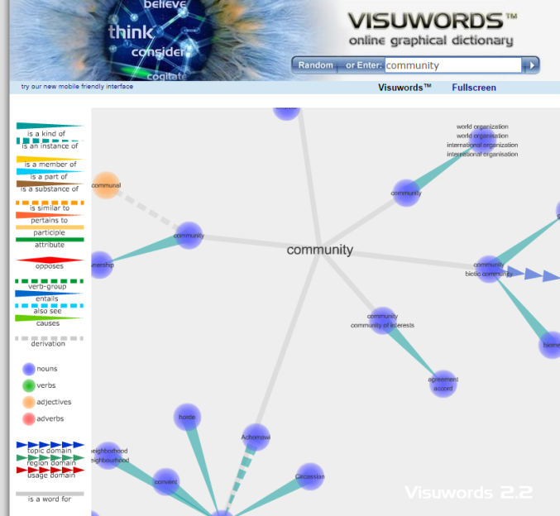
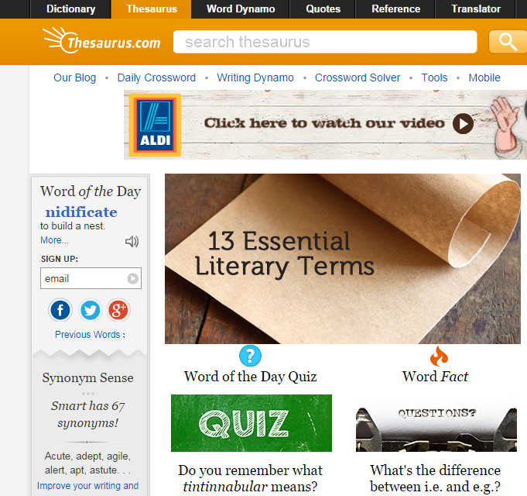
Synonym Finders
VisuWorld online graphic dictionary http://www.visuwords.com/
Thesaurus.com http://thesaurus.com/

Slide 35
Coming up with your Search Terms
Search terms are often subject keywords
Can also be names, formulae, significant numbers, depending on what you are searching for and the sources you are using.
Defining your search terms:
Define the subject in one sentence, for example:
The effectiveness of using visualisation to improve knowledge sharing in non-profit organisations
Split this sentence into concepts
discard words which merely describe the relationship between one concept and another, for example:
Visualisation Knowledge Sharing Non-profit organisations
For each of the concepts think of synonyms
(words with similar meaning) or related terms that would be useful.
Look up your terms in the thesaurus and this will tell you related or preferred terms

Slide 36
Coming up with your Search Terms
Use these terms in your search.
The way that you input and combine terms will depend on the source that you are using.
Look up your terms in the thesaurus and this will tell you related or preferred terms, for example:
Visualisation; Visualization; Representation; Graphical
Knowledge; Information;
Knowledge Sharing; Knowledge Management; Knowledge Transfer; Communities of Practice
Non-profit organisations; Government; Non-commercial; Voluntary; Educational

Slide 37
Identify some Keywords for this Topic
What is the Effect of Regular Playing Of First Person Shooter Games on Secondary School Results?
effect
games
Secondary school

Slide 38
Limitations of Search Engines
Information 'hidden' from search engines
Many sources of academic information, including important journals, are hidden from search engines
In particular older references may be less likely to be on the web.
Quality of information
Search engines can lead you to incorrect information, or information at the wrong level.
Google scholar is better in this respect, but still has the other limitations.
Quantity of information
A particular journal article reference can turn up many times in a search engine results set, whereas in a database search it would only appear only once.
Limited search options
Keyword type searching is the main search facility on search engines.
Databases can offer additional options, including controlled vocabulary searching (using a thesaurus, subject headings) and citation / cited reference searching.
For some subjects, specialised search options may also be available

Slide 39
Research Sites

Slide 40
Digital Libraries
Organized collections of digital information.
Combine the structuring and gathering of information with the digital representation of that information.
Managed collection of information, with associated services
Many communities involved in digital libraries, each with quite different
concepts, emphasis, approach, agenda
Very high significance for the future of libraries

Slide 41
What is a Digital Library?
A digital library is a networked collection of digital objects – text, still images, moving images, sound, data – with arrangement, search features, and metadata that allow for discovery and presentation, supporting research and teaching, and with attention paid to architecture, persistence, longevity, and digital preservation.

Slide 42
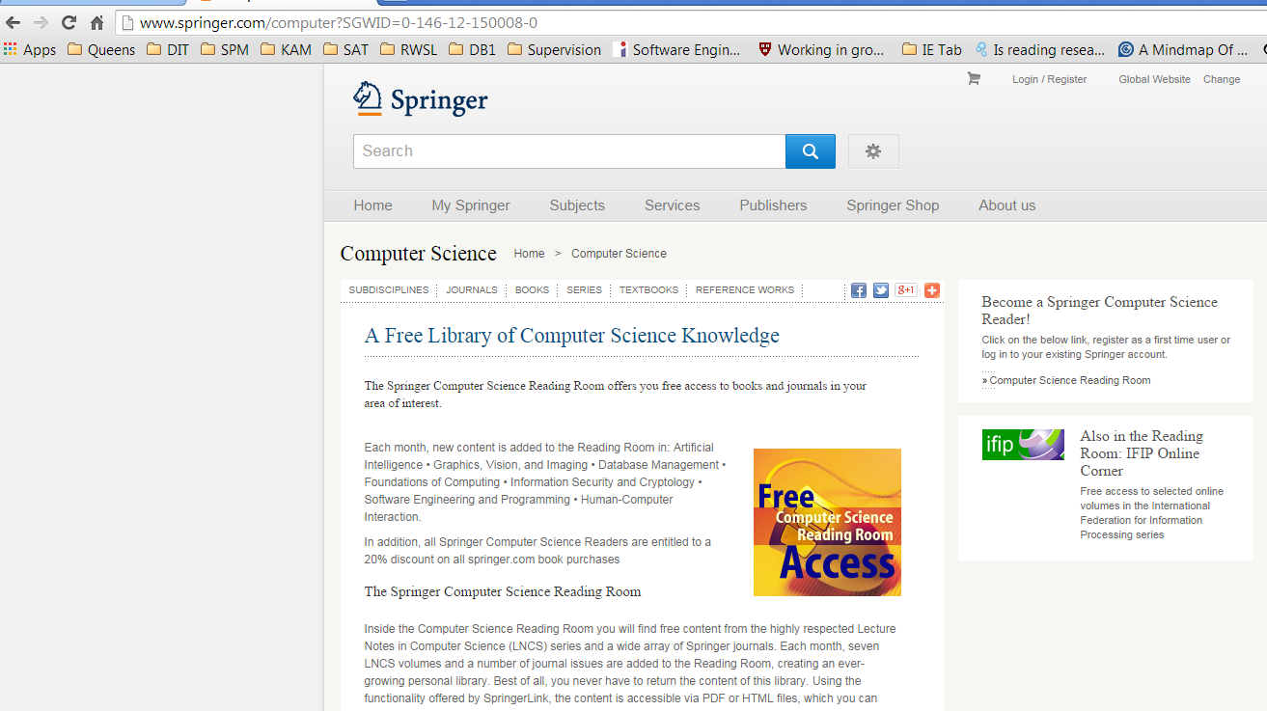
Springer
http://www.springer.com/computer?SGWID=0-146-12-150008-0

Slide 43
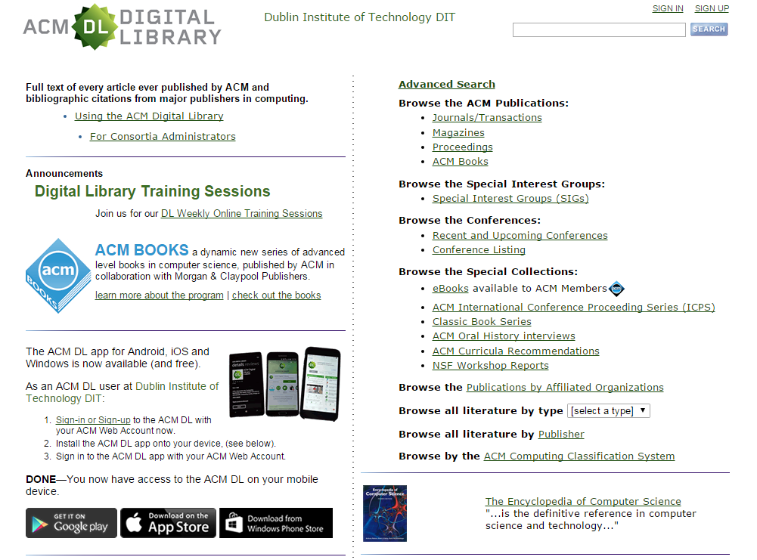
ACM Digital Library
http://dl.acm.org/

Slide 44
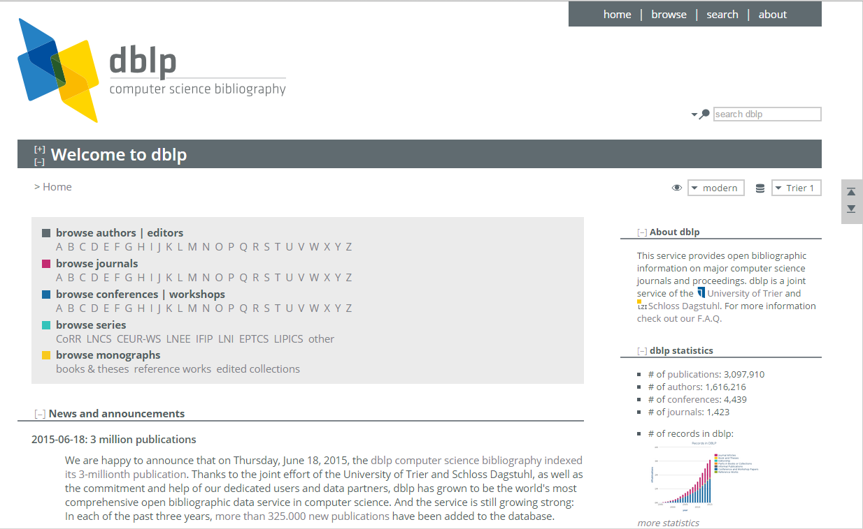
DBLP

Slide 45
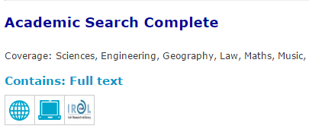
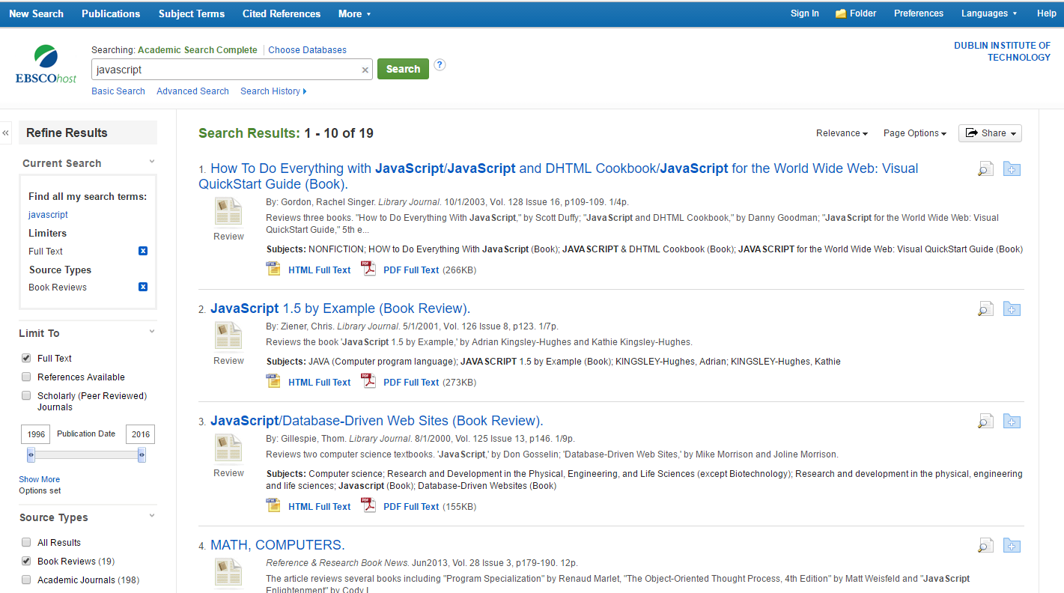
Databases
Academic Search Complete
http://www.dit.ie/library/databases/
Notes:
e.g. javascript full text book reviews

Slide 46
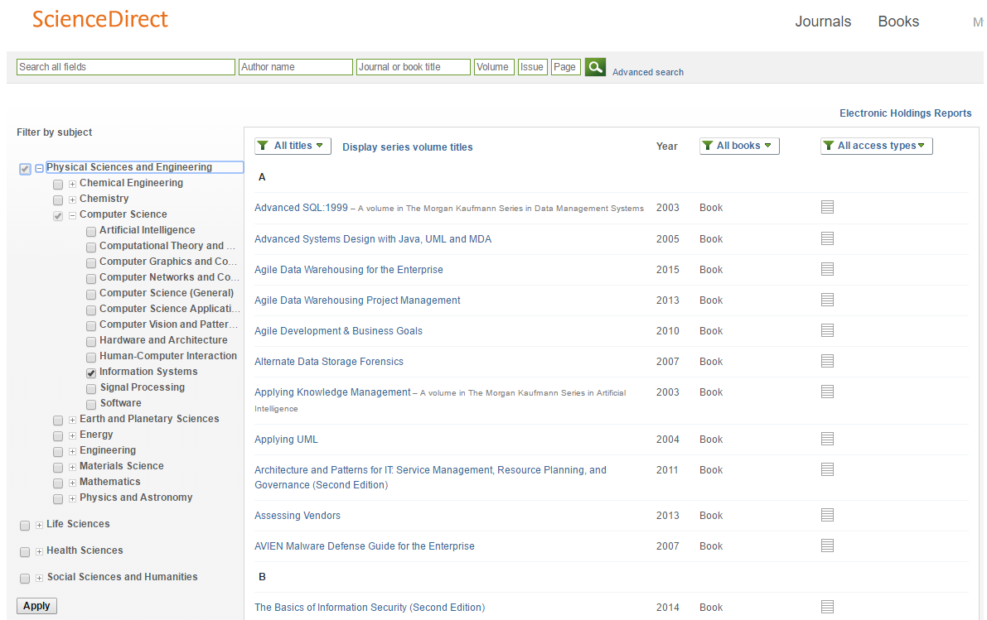
Databases
http://www.sciencedirect.com/science/bookbshsrw/sub/infosys
Notes:
e.g. information systems books

Slide 47
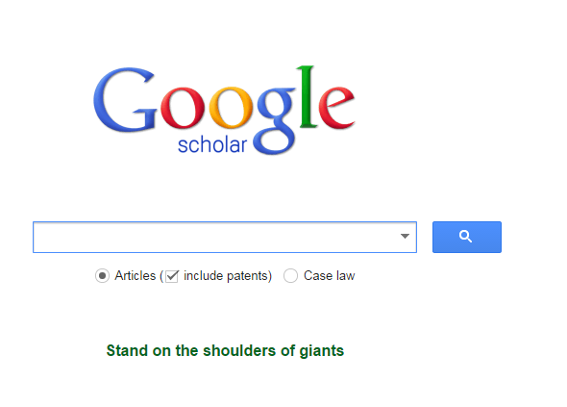
Search Engines: Google Scholar
Operators and search help
http://support.google.com/websearch/bin/answer.py?hl=en&answer=136861
Google Search Tools and Filters
https://support.google.com/websearch/answer/142143?hl=en&ref_topic=3180167

Slide 48
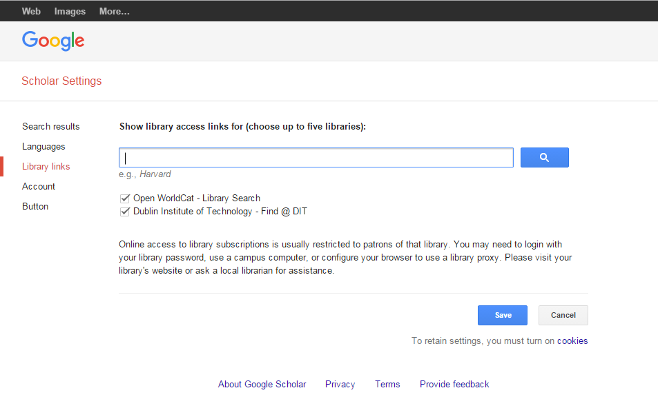
Google Scholar

Slide 49
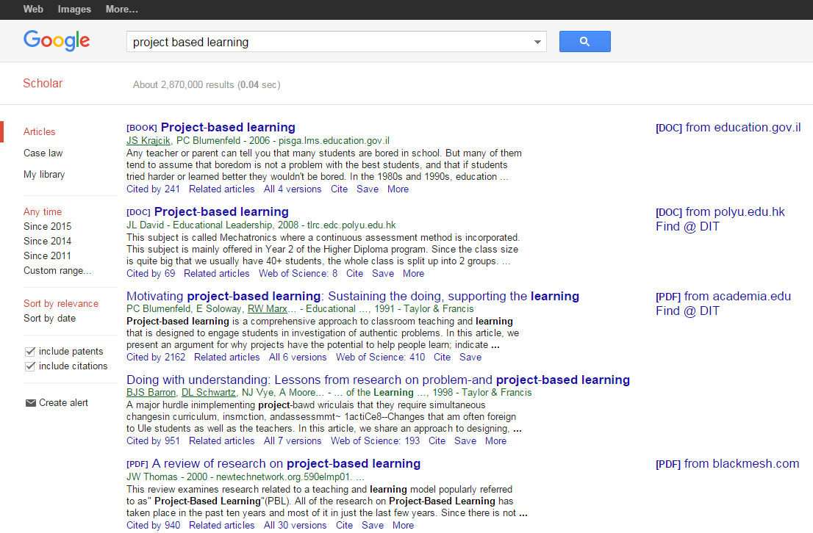
Google Scholar

Slide 50
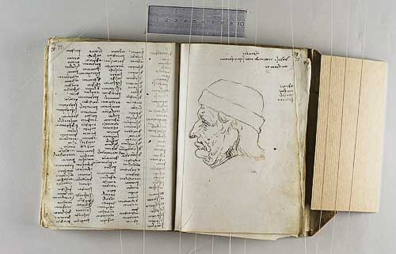
Literature Survey
list all the keywords you’ve tried
record ideas you have about your research
record details of reading you have done and what you think of it.

Slide 51

Who are ACM?
The Association for Computing Machinery, or ACM, is a learned society (academic association) for computing.
It was founded in 1947 as the world's first scientific and educational computing society.
ACM is organized into over 170 local chapters and 35 Special Interest Groups (SIGs), through which it conducts most of its activities.
Many of the SIGs, like SIGGRAPH, SIGPLAN, SIGCSE and SIGCOMM, sponsor regular conferences which have become famous as the dominant venue for presenting new innovations in certain fields.
The groups also publish a large number of specialized journals, magazines, and newsletters.

Slide 52
ACM Journals
Computing Reviews
Computing Surveys
Journal of Data and Information Quality (JDIQ)
Journal of Experimental Algorithmics (JEA)
Journal of the ACM (JACM)
Journal on Computing and Cultural Heritage (JOCCH)
Journal on Educational Resources in Computing (JERIC) -- Discontinued, replaced by Transactions on Computing Education (TOCE)
Journal on Emerging Technologies in Computing Systems (JETC)
ACM Letters on Programming Languages and Systems (LOPLAS) (No Longer Published)
Transactions on Accessible Computing (TACCESS)
Transactions on Algorithms (TALG)
Transactions on Applied Perception (TAP)
Transactions on Architecture and Code Optimization (TACO)
Transactions on Asian Language Information Processing (TALIP)
Transactions on Autonomous and Adaptive Systems (TAAS)
Transactions on Computation Theory (TOCT)
Transactions on Computational Logic (TOCL)
Transactions on Computer-Human Interaction (TOCHI)
Transactions on Computer Systems (TOCS)
Transactions on Computing Education (TOCE) -- Replaces Journal on Educational Resources in Computing (JERIC)
Transactions on Database Systems (TODS)
Transactions on Design Automation of Electronic Systems (TODAES)
Transactions on Economics and Computation (TEAC)
Transactions on Embedded Computing Systems (TECS)
Transactions on Graphics (TOG)
Transactions on Information and System Security (TISSEC)
Transactions on Information Systems (TOIS)
Transactions on Intelligent Systems and Technology (TIST)
Transactions on Interactive Intelligent Systems (TiiS)
Transactions on Internet Technology (TOIT)
Transactions on Knowledge Discovery from Data (TKDD)
Transactions on Management Information Systems (TMIS)
Transactions on Mathematical Software (TOMS)
Transactions on Modeling and Computer Simulation (TOMACS)
Transactions on Multimedia Computing, Communications and Applications (TOMM)
Transactions on Parallel Computing (TOPC)
Transactions on Programming Languages and Systems (TOPLAS)
Transactions on Reconfigurable Technology and Systems (TRETS)
Transactions on Sensor Networks (TOSN)
Transactions on Software Engineering and Methodology (TOSEM)
Transactions on Spatial Algorithms and Systems (TSAS)
Transactions on Speech and Language Processing (TSLP)
Transactions on Storage (TOS)
Transactions on the Web (TWEB)
IEEE/ACM Transactions on Audio, Speech and Language Processing (TASLP)
IEEE/ACM Transactions on Computational Biology and Bioinformatics (TCBB)
IEEE/ACM Transactions on Networking (TON)

Slide 53
ACM SIGs
SIGACCESS - Accessible Computing
SIGACT - Algorithms and Computation Theory
SIGAda - Ada Programming Language
SIGAPP - Applied Computing
SIGARCH - Computer Architecture
SIGART - Artificial Intelligence
SIGBED - Embedded Systems
SIGCAS - Computers and Society
SIGCHI - Computer-Human Interaction
SIGCOMM - Data Communication
SIGCSE - Computer Science Education
SIGDA - Design Automation
SIGDOC - Design of Communication
SIGecom - Electronic Commerce
SIGEVO - Genetic and Evolutionary Computation
SIGGRAPH - Computer Graphics and Interactive Techniques
SIGIR - Information Retrieval
SIGITE - Information Technology Education
SIGKDD - Knowledge Discovery in Data
SIGMETRICS - Measurement and Evaluation
SIGMICRO - Microarchitecture
SIGMIS - Management Information Systems
SIGMM - Multimedia
SIGMOBILE - Mobility of Systems, Users, Data and Computing
SIGMOD - Management of Data
SIGOPS - Operating Systems
SIGPLAN - Programming Languages
SIGSAC - Security, Audit and Control
SIGSAM - Symbolic and Algebraic Manipulation
SIGSIM - Simulation and Modeling
SIGSOFT - Software Engineering
SIGSPATIAL - SIGSPATIAL
SIGUCCS - University and College Computing Services
SIGWEB - Hypertext, Hypermedia and Web
Please Note: You have limited access to ACM Digital Library via DIT.
Student memberships available for purchase.

Slide 54

IEEE
Another significant group are IEEE (Institute of Electrical and Electronics Engineers) called “eye-triple-e” is a professional organization for the advancement of technology, it also publishes a number journals,
You have full access to the IEEE digital library via the DIT Library

Slide 55
IEEE Transactions
IEEE Computational intelligence and AI
IEEE Transactions on Computers
IEEE Transactions on Dependable and Secure Computing
IEEE Transactions on Knowledge and Data Engineering
IEEE Transactions on Parallel and Distributed Systems
IEEE Transactions on Pattern Analysis and Machine Intelligence
IEEE Transactions on Services Computing
IEEE Transactions on Software Engineering
IEEE Transactions on Visualization and Computer Graphics
IEEE Transactions on Affective Computing
IEEE Transactions on Haptics
IEEE Transactions on Information Technology in Biomedicine
IEEE Transactions on Learning Technologies
IEEE Transactions on Mobile Computing
IEEE Transactions on Multimedia
IEEE Transactions on Nanobioscience
IEEE Transactions on Very Large Scale Integration (VLSI) Systems
IEEE/ACM Transactions on Computational Biology and Bioinformatics
IEEE/ACM Transactions on Networking

Slide 56
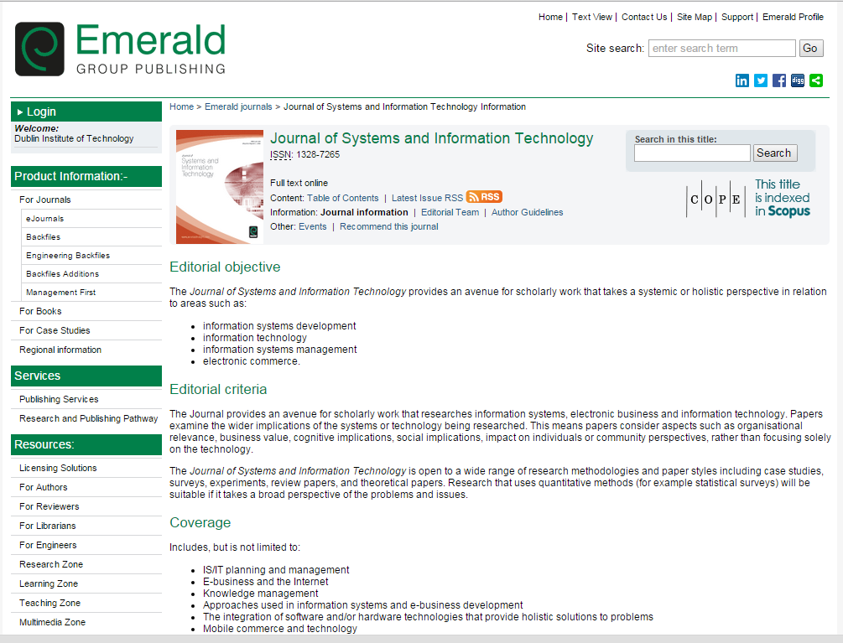
Emerald Journals

Slide 57
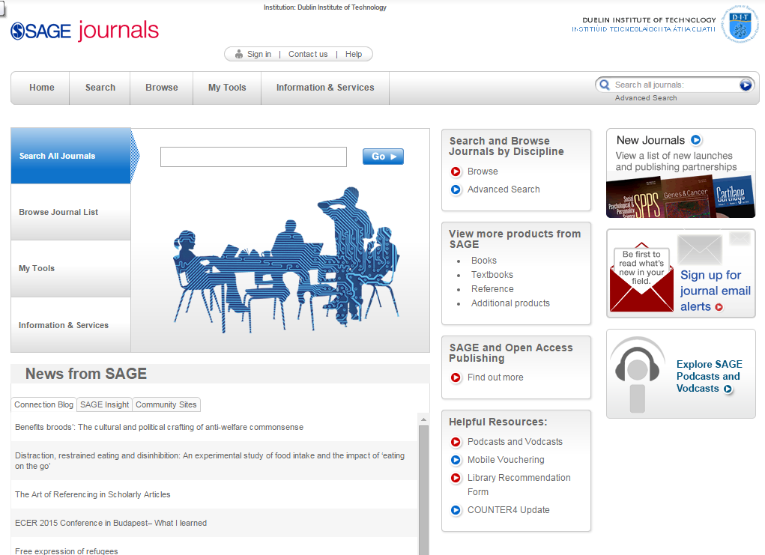
SAGE (online.sagepub.com)

Slide 58
Journal Credibility?
As you start to find out more about an area you will start to see that there are certain journals that people researching in the area target
There are numerous ways of measuring its ‘quality’
Using its ranking via the journal citation reports (available via DIT)
JCR distills citation trend data for 7,600+ journals from more than 25 million cited references every year
Science Edition and Social Science Edition released annually
Science Edition covers 5,928 journals in 171 subjects
Social Science Edition covers 1,716 journals in 55 subjects
What can we do with the JCR?
Compare a selection of journals in terms of their impact
Find related journals
Identify review journals
View citation information for subject categories

Slide 59
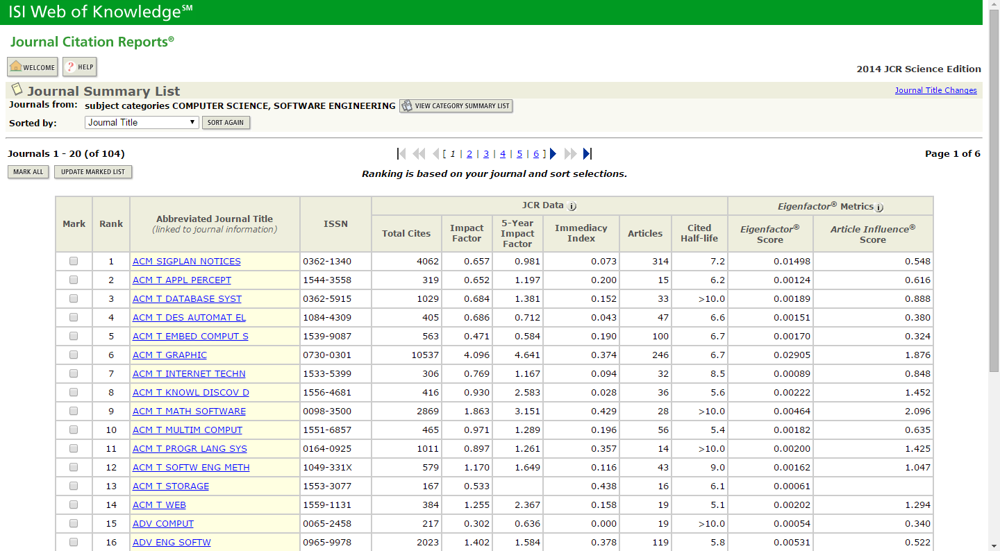
Journal Credibility?

Slide 60
Journal Credibility?
The sponsor
ACM and IEEE are highly regarded sponsors
Look at the number of citations papers you are interested in have (using Google Scholar or something like CiteSeer)
Look at the people who are on the editorial/review panel
Look at how long it has been in existence (how many volumes, how many issues per volume)

Slide 61
Peer Review
What does peer-reviewed mean?
When you submit a research paper, a number of people will read the paper and give feedback/corrections on it.
The people who review it will be as expert as you are in the field of research (and as such are your peers).
Some conferences only get one person to review a paper, others get two, others more – the more people that review conference papers, the more prestigious the conference is, since the papers in it are bound to be of very quality.
Journal papers are normally reviewed by several people, and are considered very credible.

Slide 62
Conference Credibility?
How do you identify the top level conferences in computer science?
Look at sponsor
Again ACM and IEEE sponsored conferences are well regarded
BUT international conferences are more highly regarded than local ones
Look at how long it has been running
Look at the people involved in the committees
Look at the original call for papers
What type of topics were of interest?

Slide 63
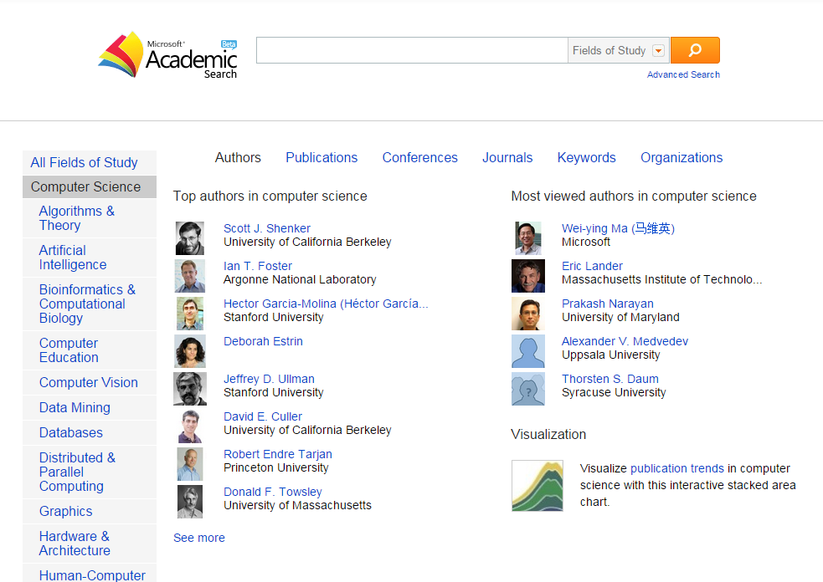
Sources
Microsoft Academic Search
http://academic.research.microsoft.com/

Slide 64
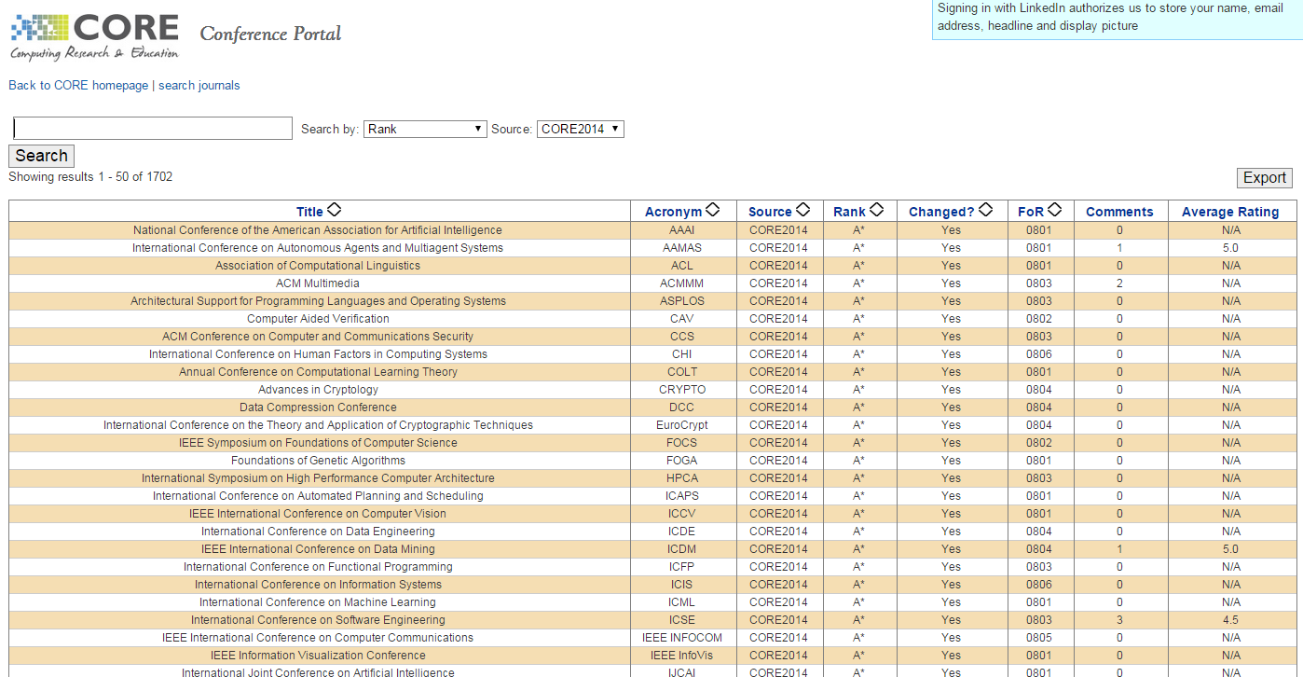
Computer Science Conference Rank
http://www.core.edu.au/index.php/conference-rankings

Slide 65
Snowball Technique
As you read you will redefine your focus through searches
You will become familiar with authors and texts commonly cited and start to look for specific papers
Snowball technique is when you follow up references from bibliographies of texts you read
Keep a record

Slide 66
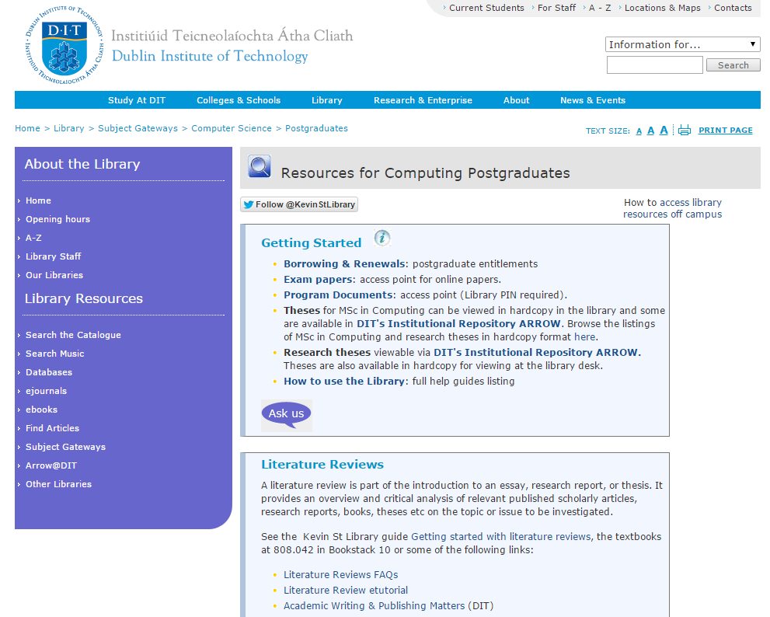
DIT Library
http://www.dit.ie/library/subjects/computerscience/postgraduates/

Slide 67
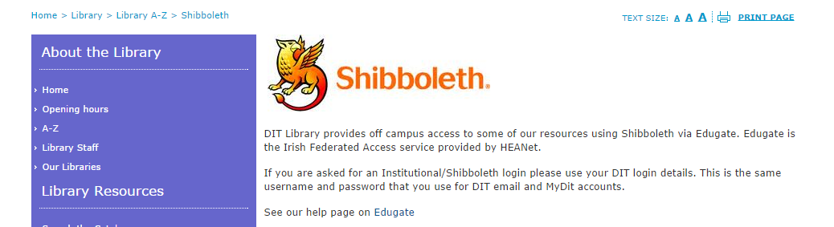
Accessing resources from outside DIT
You will need your DIT Library pin
If you access a resource directly (without going through a DIT library link) you will be using the Shibboleth system
For this you will need your DIT username and password

Slide 68
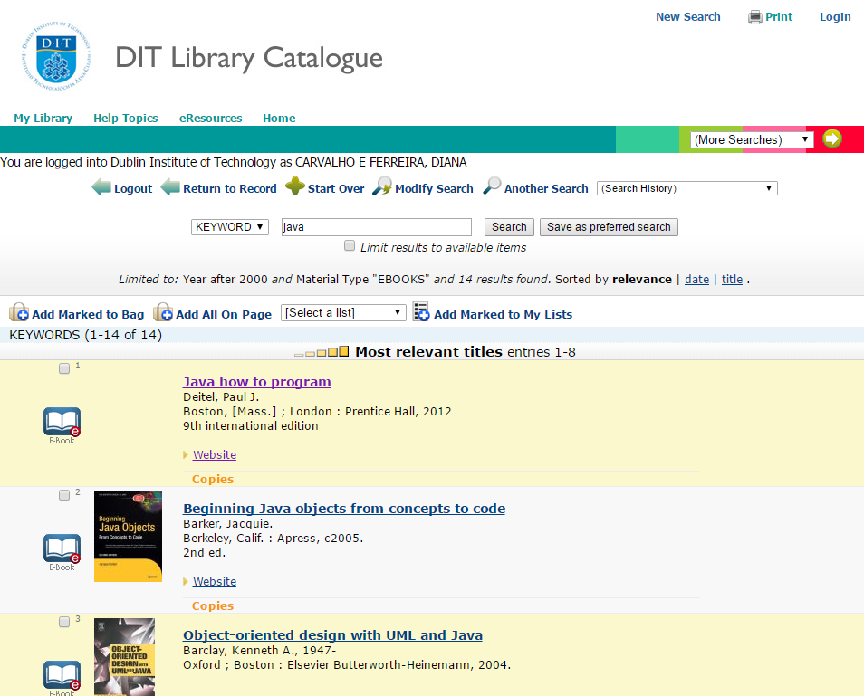
DIT Library
Notes:
e.g. Java ebooks since 2000

Slide 69
Activity
Think of a topic of your interest
List some keywords that will help you locate relevant material
Refine your list and complete the search worksheet (Steps 1-4)
Template on webcourses
An example is included in pdf
Investigate a number of resources (available via the DIT Library) using your keywords
Summon (http://dit.summon.serialssolutions.com/#!/)
Google Scholar (remember to setup your library access in the settings)
Academic Search Complete (use the advanced search option)
ScienceDirect (use the advanced search option)
Complete the search worksheet (Steps 5-7)
Discussion: which were the most effective resources for your topic?

